Slide 1
Inova Biomedical Internship in Chronic Diseases
Fall 2015

Slide 2
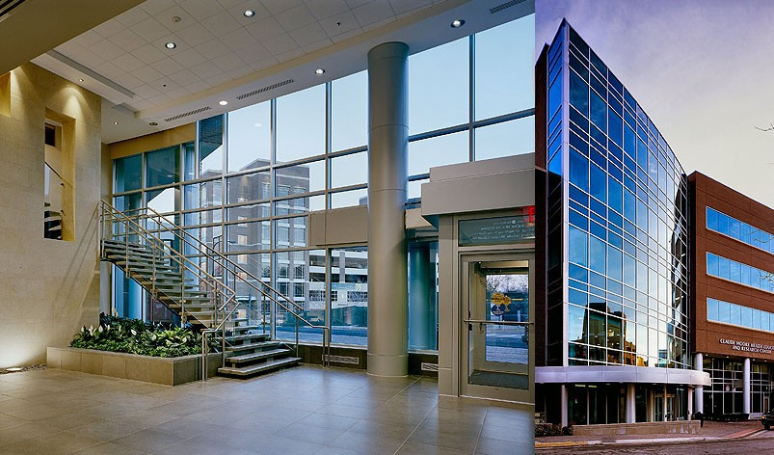
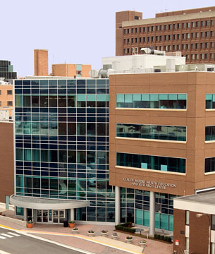
Center for the Study of Chronic Metabolic Diseases
Collaboration between George Mason University & Inova Fairfax Hospital
Claude Moore Research Building, Inova Fairfax Hospital
Co-Directors of CSCMD:
Dr. Ancha Baranova
Dr. Aybike Birerdinc
With support of Dr. Zobair Younossi (Inova)

Slide 3
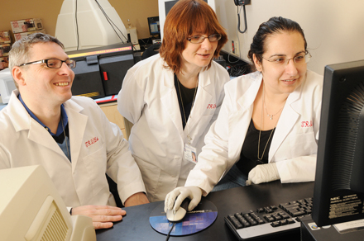
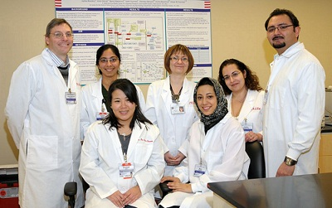
Program Information
Inova Biomedical Internship is targeted for College of Science Biology and Chemistry undergraduate (sophomores, juniors and seniors)
Research experience is great addition to your CV /resume pre-job or pre- graduate program
Work with medical care providers in research for pre-med students.
8-10 internships a year
(495 or 497 credits – Directed research)
Skills to learn:
qRT-PCR, ELISA assays, cell culture, data analysis and scientific review writing
Current Program Dates:
September 1 –December 21, 2015
Note: Program end date is flexible

Slide 4
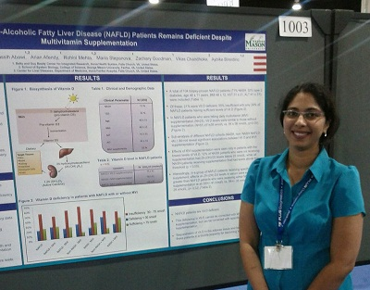
What would you gain
Learn to solve hypothesis driven questions – go beyond the text book
Gain research experience in a hospital laboratory environment
Enhance scientific writing and presentation skills
Present results of your research project at College of Science Undergraduate Research Colloquium and Virginia Academy of Science Conferences
Sample oral presentation http://prezi.com/bbipy7_-5rs-/vas-revised_1/

Slide 5
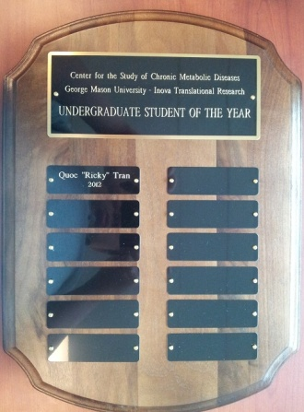
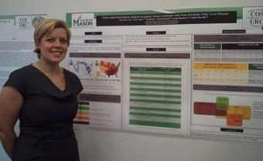
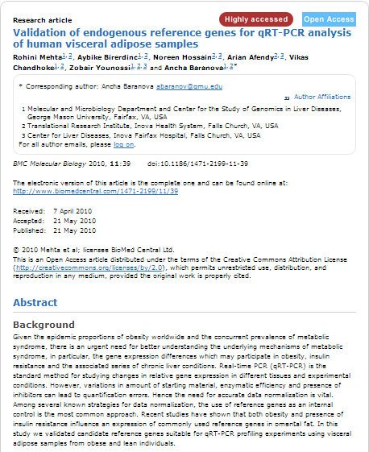
Your Gains
Compete for CSCMD Undergraduate Research Student of the Year Award; Best Oral Presentation and Best Poster Presentation at VAS and variety of undergraduate conferences.
Apply for stipends/grants through VAS, NIH, OSCAR, etc.
Potentially become co-authors on peer-reviewed publications
Potentially receive letters of recommendation
Receive a certificate of completion at the end of the internship
Earn 1-3 credits of BIOL 495 or BIOL 497

Slide 6
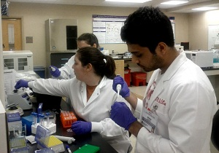
How to apply
Application can be found here: http://cscmd.cos.gmu.edu/internship.html
Please email the completed application form and resume to cscmd.gmu@gmail.com by 11:59pm April 25, 2015.
(copy to peter.masschelin@gmail.com )
Please write in the subject line: “ATTN: Inova Biomedical Internship in Chronic Diseases Fall 2015 – [Your first name and last name].”
A confirmation receipt will be sent to the applicant. If you do not get a confirmation receipt within 7 days, please email to let us know.
Students will receive notification of acceptance
after in person interview

Slide 7
FAQs
How many credits should I sign up for the program?
In addition to the GMU Lab Safety Training, Inova Orientation, VAS Conference, interns are expected to spend the following hours:
4 – 6 hours per week for 1 credits
8 – 12 hours per week for 2 credits
15 – 18 hours per week for 3 credits
I am a business major; however, I have taken college foundation biology courses, I want to pursue health profession career in the future, am I eligible for this internship?
Yes, absolutely! In fact, we do have a few exceptional non-science majors in our research center so you are encouraged to apply.
3. I am just a freshman; however, I was involved in research at high school (Ex: VJAS), Can I apply for this internship?
Yes, absolutely!

Slide 8
FAQs
3. Is previous research/lab work experience is required?
No, it is not required
4. When do I receive the result?
Only selected interns will be contacted. The offers are made in early-May for summer intern and mid-June for fall intern.
5. How will my research work be graded?
It will be graded based on the initiative towards your project, completion of your research, quality of the draft research paper and your attendance of conferences.

Slide 9
FAQs
6. Do I have to pay to attend the Virginia Academy of Science Conference?
We will reimburse interns the registration fee, lodging and travel cost. However, all interns are responsible for their membership fees (Membership fee of VAS is $15)
7. If something comes up at the end of the semester (exams, family issue, etc) prevent me of completing my project on time, what should I do?
The end date of the project is flexible, you will receive an extension to complete your research up to 9 weeks in the following semester if it is necessary.
8. Can previous applicants and participants reapply for the internship program?
Yes, previous applicants and participants are eligible to reapply.

Slide 10
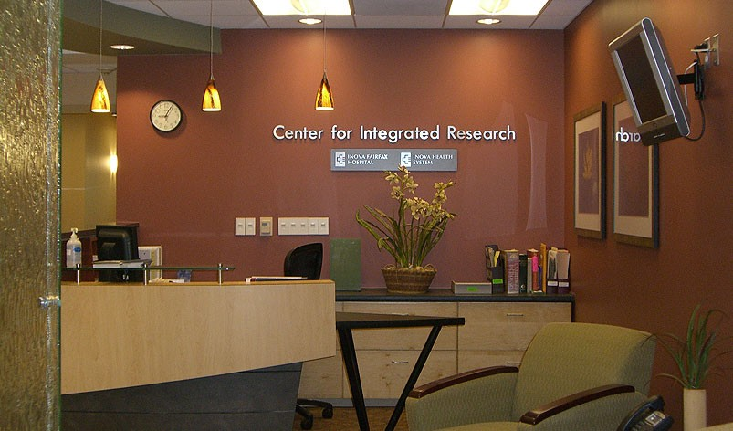
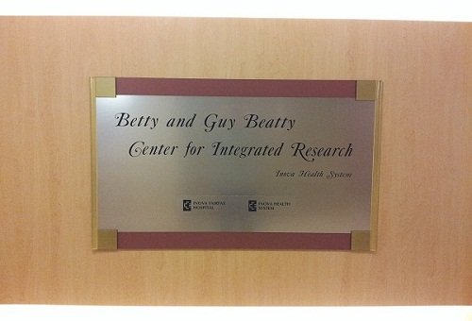
Questions?
Contacts:
peter.masschelin@gmail.com
http://cscmd.cos.gmu.edu/

